Slide 1
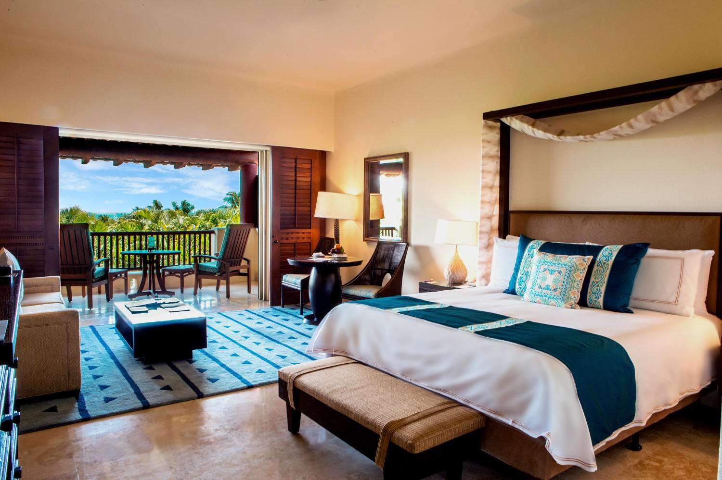
HOTEL RESERVATION ANALYSIS

Slide 2
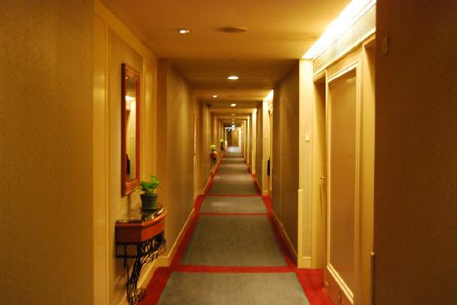
TOTAL NUMBER OF ROOMS IN THE DATASET
They are six (6) Rooms in the Dataset
Room 1
Room 2
Room 4
Room 5
Room 6
Room 7

Slide 3
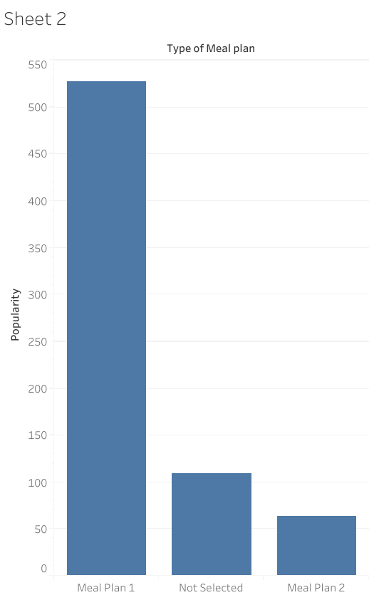
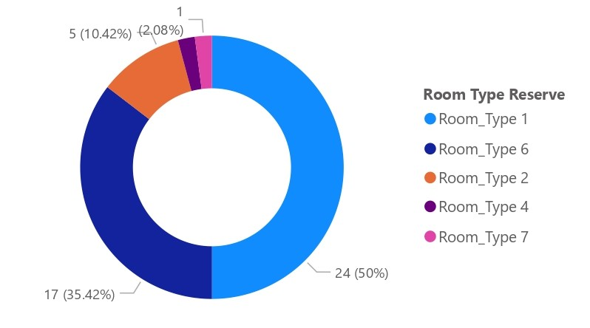
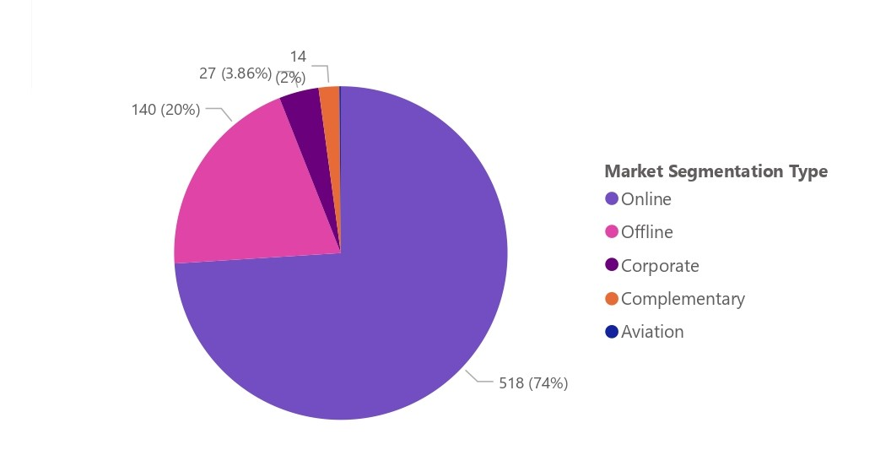
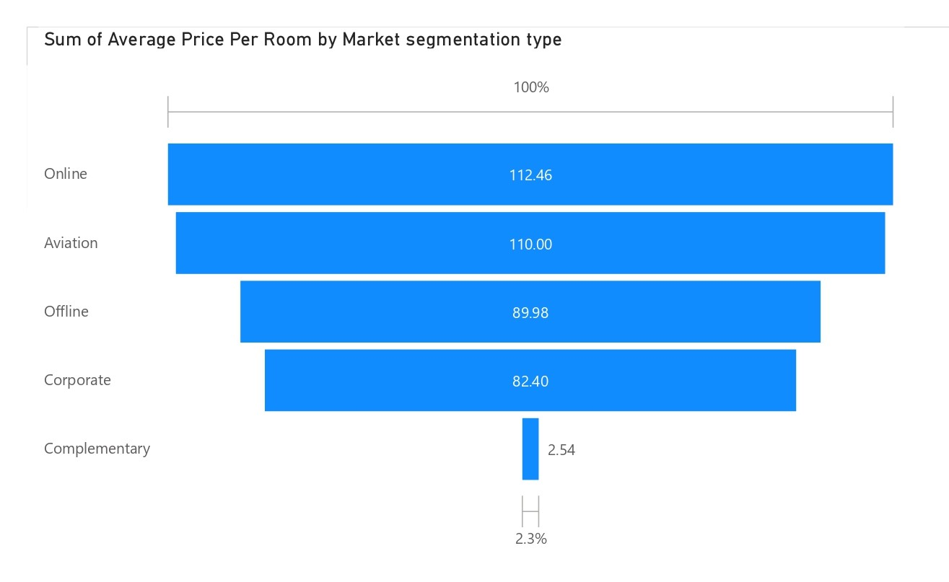
VISUALIZATION
Showing the most popular meal plan here
which is meal plan 1
Showing reservations involving children, and bringing out the most common room type, and the average
price for that room type
Therefore: The most common room type is Room type 1 with Average price of 24(50%)
Showing the market segment type that generates the highest average price per room
Therefore: The market segment type that generate the highest average price per room is “Online” with average price of 112.46
Showing the most common market segement here which is “Online” with 518 market segment

Slide 4
Showing the average price per room for reservations involving children
Booking ID | No of Children | Average Price |  |  |  | Booking ID | No of Children | Average Price
INN00033 | 2 | 82.44000244 |  |  |  | INN00342 | 1 | 103.6999969
INN00061 | 2 | 258 |  |  |  | INN00356 | 1 | 168.25
INN00081 | 2 | 159.3000031 |  |  |  | INN00371 | 2 | 199
INN00096 | 1 | 130.5 |  |  |  | INN00383 | 2 | 147.8999939
INN00100 | 2 | 156.8999939 |  |  |  | INN00389 | 2 | 221
INN00115 | 2 | 184.2400055 |  |  |  | INN00392 | 1 | 73.83000183
INN00118 | 1 | 102.8300018 |  |  |  | INN00396 | 1 | 152.1000061
INN00128 | 2 | 190.8000031 |  |  |  | INN00408 | 1 | 156.6100006
INN00137 | 1 | 121.5 |  |  |  | INN00457 | 1 | 106.4300003
INN00170 | 1 | 87.40000153 |  |  |  | INN00469 | 1 | 168
INN00175 | 1 | 150 |  |  |  | INN00476 | 2 | 187.0399933
INN00179 | 1 | 87.77999878 |  |  |  | INN00488 | 2 | 83.02999878
INN00218 | 1 | 86.31999969 |  |  |  | INN00532 | 1 | 122
INN00227 | 2 | 177.6499939 |  |  |  | INN00537 | 1 | 172.8000031
INN00228 | 2 | 200.75 |  |  |  | INN00542 | 1 | 106
INN00229 | 1 | 127 |  |  |  | INN00549 | 1 | 121.5
INN00232 | 1 | 135.1499939 |  |  |  | INN00555 | 2 | 186.2200012
INN00235 | 1 | 125.0999985 |  |  |  | INN00615 | 2 | 95
INN00287 | 2 | 187.8500061 |  |  |  | INN00623 | 2 | 156
INN00288 | 2 | 108.3799973 |  |  |  | INN00654 | 2 | 115.6800003
INN00293 | 1 | 76.5 |  |  |  | INN00665 | 1 | 195.5
INN00299 | 1 | 104.5 |  |  |  | INN00682 | 2 | 172.5500031
INN00312 | 2 | 239 |  |  |  | INN00684 | 1 | 166.3500061
INN00324 | 1 | 132.8999939 |  |  |  | INN00700 | 1 | 150

Slide 5
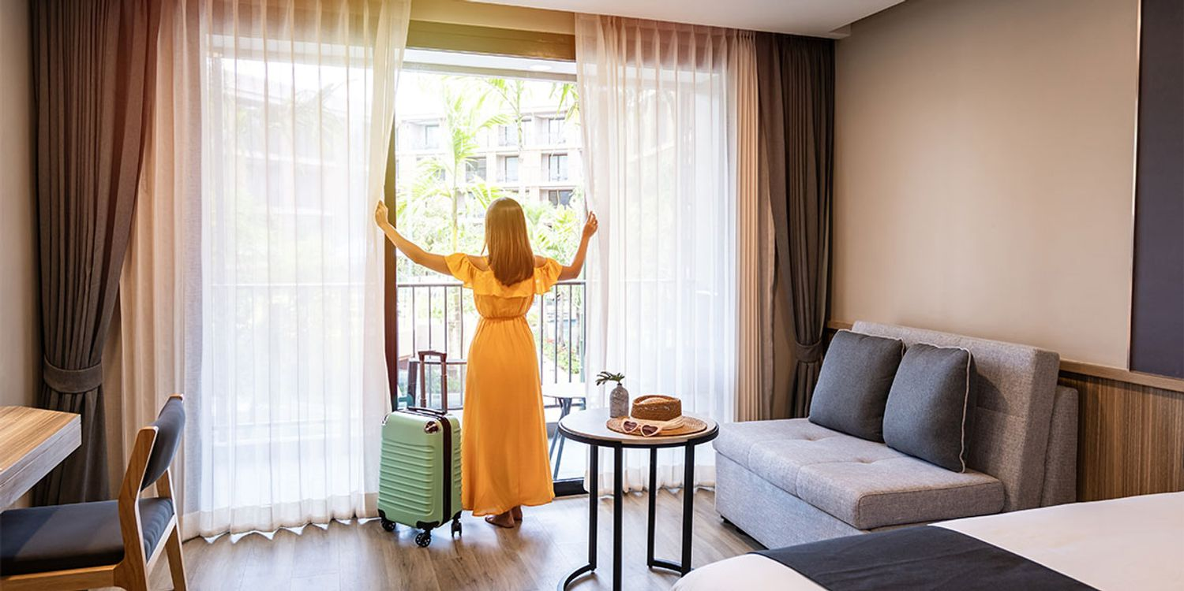
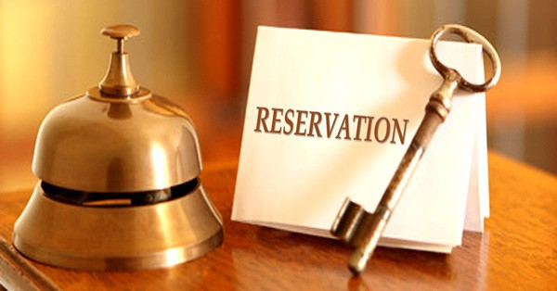

This is showing how many reservations were made for the year 2018, The most commonly booked room type and how many reservations fall on a weekend
Total No of reservations made in 2018
Most commonly booked room
Total No of Reservation fall on a weekend
Room type 1
Booked 538 times
577
383

Slide 6
Showing the highest and lowest lead time for reservations
Showing the average number of nights (both weekend and weekday) spent by guests for each room type
Highest Lead Time | Lowest Lead Time
443 | 1
Room Type Reserved | Average Total Night
Room type 1 | 2
Room type 2 | 3
Room type 4 | 3
Room type 5 | 2
Room type 6 | 3
Room type 7 | 2
Total No of adults and children accross the reservation
Total no of adults | Total no of children
1316 | 69
Average number of weekend nights for reservations involving children
1

Slide 7
THANK YOU

